Slide 1
Secure data hiding in images using steganography
CAPSTONE PROJECT
Presented By:
Student Name : Jeevitha K
College Name & Department : Cauvery Institute of Technology, Mandya &
Computer Science and Engineering (CSE)

Slide 2
OUTLINE
Problem Statement
Technology used
Wow factor
End users
Result
Conclusion
Git-hub Link
Future scope

Slide 3
Problem Statement
In the digital age, ensuring the privacy and security of sensitive data is critical.
Many communication methods can be intercepted or monitored, making it necessary to find discreet ways to share information.
The need for secure communication and hiding sensitive messages has grown.
Conventional encryption methods might not always be convenient or suitable for hiding messages in plain sight.

Slide 4
Technology used
OpenCV (cv2)
An open-source computer vision library used for image processing.
Functions like cv2.imread and cv2.imwrite are used for reading and writing images.
OS Module
Used to interact with the operating system, specifically to open the encrypted image file after encryption.
Python:
A versatile programming language for data processing, image manipulation, and cryptography.
IDLE (Python 3.13 64 – bit)
These is commonly used to write and debug Python code.

Slide 5
Wow factors
Invisible Security:
Secret messages are hidden in the image without altering its visible appearance.
The message can only be extracted by someone who knows the correct password.
Interactive:
User inputs the message and password during encryption and needs to match the password during decryption to reveal the hidden message.
Dual-Purpose Image:
The image serves as both an artwork and a secure message carrier.
Multiple Use Cases:
Secure Communication: Share sensitive information without suspicion.
Stealth Data Transmission: Avoid detection in environments where data transfer is monitored.

Slide 6
End users
Individuals:
People who wish to securely share confidential messages, like personal communications or secret notes.
Organizations and Corporations:
Businesses looking for a simple, yet effective way to share sensitive data securely without using traditional encryption methods.
Cryptography Enthusiasts:
Developers and hobbyists interested in cryptography, steganography, and image processing techniques.
Security Enthusiasts:
People interested in cryptography and data security applications.

Slide 7
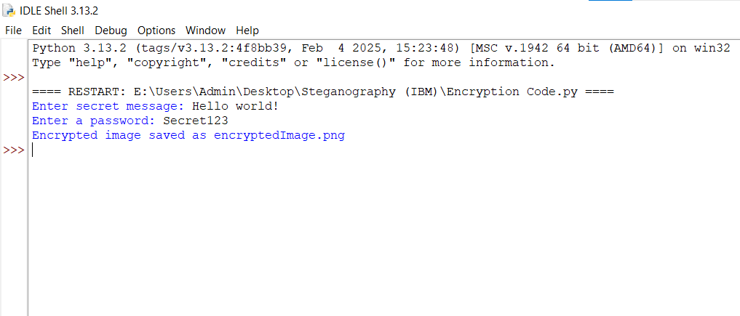
Results

Slide 8
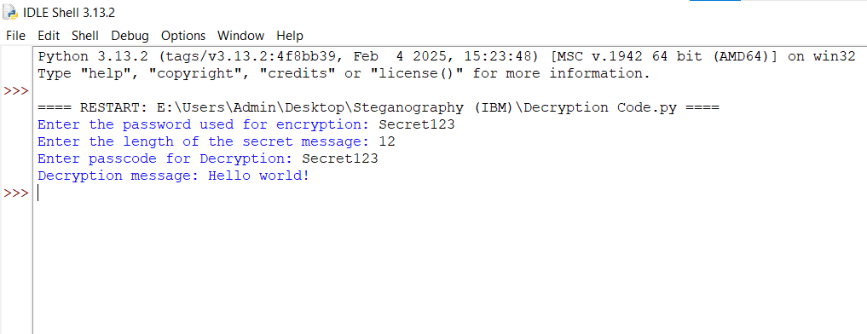
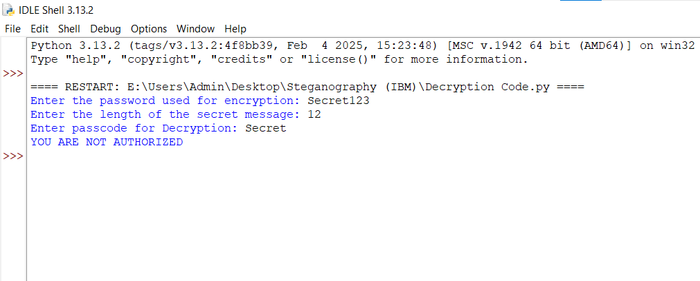

Slide 9


Normal Image Encrypted Image

Slide 10
Conclusion
Advantages:
The solution is easy to use and provides an extra layer of security for sensitive information.
It’s a great introduction to steganography and cryptography for beginners.
Limitations:
It relies on basic encryption and might not be secure enough for high-risk applications.
The image could still be detected as "manipulated" by sophisticated systems.
Practical Applications:
Secure Communication: Share confidential data without leaving a digital trace.
Protecting intellectual property (e.g., watermarking with hidden data).

Slide 11
GitHub Link
https://github.com/Jeevithak-18/Steganography.git

Slide 12
Future scope(optional)
Enhanced Security:
Implement stronger encryption algorithms like AES or RSA for more secure data hiding.
Use digital signatures for verification during encryption/decryption.
Video Steganography:
Expand this technique to hide messages in video files, not just images.
Automated Password Management:
Add features that manage encryption/decryption passwords through secure means, like hash-based storage or biometric authentication.
AI Integration:
Use AI to detect patterns and select the best pixels for hiding messages, making the encryption even harder to detect.

Slide 13
THANK YOU

